Slide 1
React Router and Single Page Applications

Slide 2
Objectives
Identify the salient features and uses for the various types of components
Create presentational, container and functional components in your React application
Set up the router module to enable navigation among multiple component views
Set up the routes to enable the navigation
Design SPA using React
Use the React router to construct SPA

Slide 3
Presentational and Container Components

Slide 4
Component Types
Can be classified based how they are used
Presentational vs Container
Skinny vs Fat
Dumb vs Smart
Stateless vs Stateful

Slide 5
Presentational Components
Mainly concerned with rendering the “view”
How things look (markup, styles)
Render the view based on the data that is passed to them in props
Do not maintain their own local state
Can be relaxed to maintain only UI state than data

Slide 6
Container Components
Responsible for making things work
Data fetching, state updates
Make use of presentational components for rendering
Can wrap presentational components in wrapping divs
Provide the data to the presentational components
Maintain state and communicate with data sources

Slide 7
Exercise 26: Presentational and Container Components
Organizing your React app into presentational and container components
Enable your presentational components to be concerned with the look and feel of your app
Enable container components to deal with the state, provide the data and handle user interactions.

Slide 8
Functional Components

Slide 9
Class Components
Extend React.Component to get class components
Need to implement the render() method that returns the view
Can have local state
Lifecycle hooks

Slide 10
Functional Components
Simplest way to define React components
JavaScript function that returns a React element, or a collection of React elements that define the view
Receives a “props” object as a parameter
Cannot have local state or access lifecycle hooks

Slide 11
Exercise 27: Functional Components
Implement functional components in React
Illustrate the reimplementation of presentational components as pure functional components

Slide 12
React Router

Slide 13
React Virtual DOM
Browser DOM is a browser object
Virtual DOM is a React object
A lightweight representation of the Browser DOM
In-memory tree data structure of plain JS objects
Manipulations extremely fast compared to modifying the browser DOM
Created completely from scratch on every setState

Slide 14
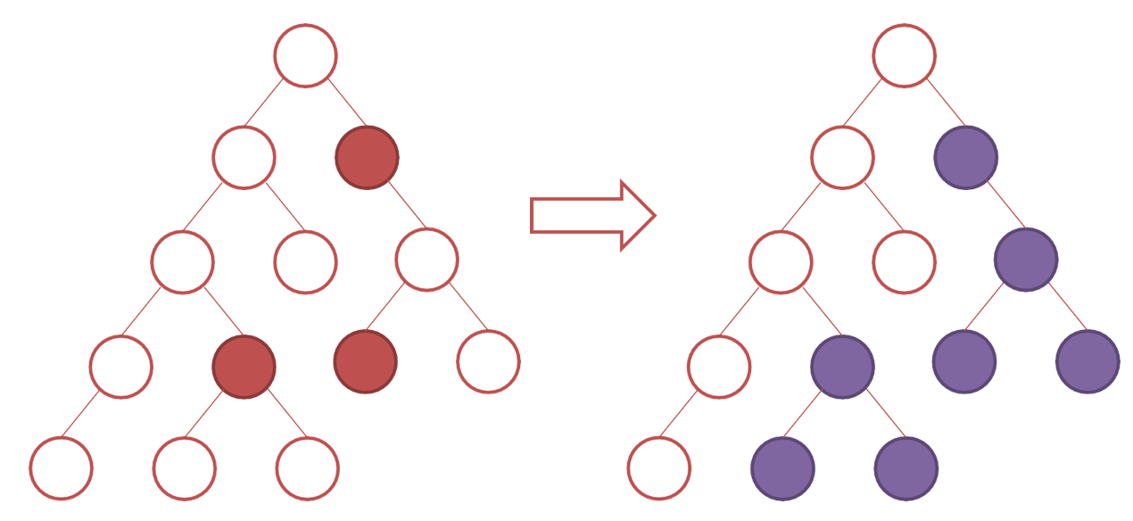
Virtual DOM Diffing and Re-rendering

Slide 15
Updating the DOM
Diffing algorithm will detect those nodes that are changed
Updates the entire sub-tree if diffing detects that two elements are of different types
Using “key” you can hint child elements as stable
No need to re-render where keys do not change
React Fiber: new reconciliation algorithm in React 16
Incremental rendering

Slide 16
Exercise 28: Header and Footer
Use multiple components and their views to put together the view of the application.
Make use of Font Awesome icons and Bootstrap-social within your React application

Slide 17
React Router
Collection of navigational components
Enables navigation among views
Router components, route matching components and navigation components
Uses a browser-based bookmarkable URLs as an instruction to navigate to a client-generated view in your web app
Can also pass along optional parameters

Slide 18
Web App Routing
Install react-router-dom
Router component: <BrowserRouter>
Creates specialized history object
Also <HashRouter> if you are using a static file server
Enclose your app in BrowserRouter

Slide 19
Route Matching
Route matching components: <Route> and <Switch>
<Route>’s path prop enables specification of the current location’s pathname
<Route>’s component prop specifies the corresponding view for the location
Using exact attribute ensures that the path must be exactly matched
<Redirect> enables the default route specification
<Switch> enables grouping together several routes
Will iterate over all its children and find the first one that matches the path

Slide 20
Navigation
Navigation is supported through the <Link> and <NavLink> components:
<Link> creates links in your application
Will render as <a> in the HTML
<NavLink> also attaches the active class to the link when its prop matches the current location

Slide 21
Exercise 29: React Router
Install and configure your application to use React Router
Configure the routes for React router to enable you to navigate to various pages within your React application

Slide 22
Single Page Applications (SPA)

Slide 23
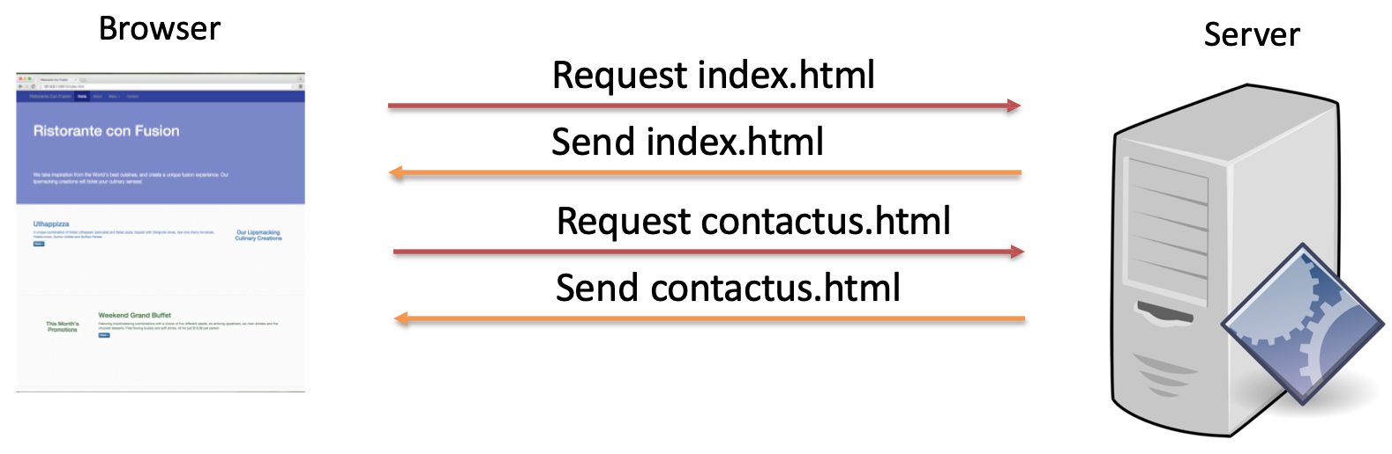
Traditional Web Sites

Slide 24
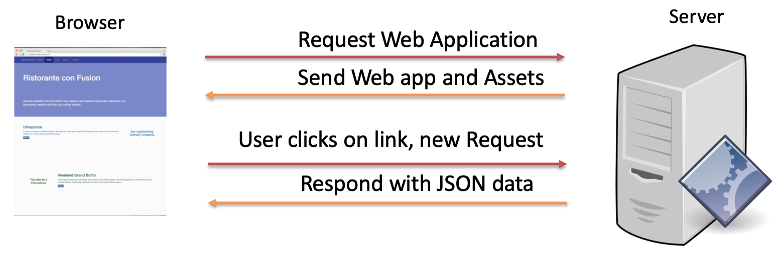
Single Page Applications

Slide 25
What is Single Page Application?
Web application or web site that fits in a single page
No need to reload the entire page
UX like a desktop/native application
Most resources are retrieved with a single page load
Redraw parts of the page when needed without requiring a full server roundtrip

Slide 26
Challenges in SPA
Search engine optimization
Partitioning the responsibility between client and server
Maintaining history
Analytics
Speeding up the initial page load

Slide 27
Exercise 30: Single Page Applications Part 1
Leverage the React router to enable the development of single page applications
Provide a way of navigating among various pages using the React router support.

Slide 28
React Router: Parameters

Slide 29
React Router
Paths specified as a URL
Paths can also carry parameter values:
e.g., /menu/42 where 42 is a route parameter
Route parameters specified in the path specification as a token
e.g., path: ‘menu/:id’ where id is the token

Slide 30
Route Parameters
Route parameters can be specified using a link parameter while specifiyng the link
e.g., <Link to{`/menu/${dish.id}`} >
Route passes three props to the component:
match, location, history

Slide 31
match Object
match object provides information about how a <Route path> matched the URL
params: an object that contains key/value pair parsed from the URL corresponding to the dynamic segments of the path
e.g. if path is specified as /menu/:id, then a path like
/menu/42 will result in match.params.id being equal to “42”

Slide 32
Exercise 31: Single Page Applications Part 2
Configure the routes in your React router configuration to enable the use of route parameters within the URL to pass information to a component

Slide 33
Summary
Identify the salient features and uses for the various types of components
Create presentational, container and functional components in your React application
Set up the router module to enable navigation among multiple component views
Set up the routes to enable the navigation
Design SPA using React
Use the React router to construct SPA

